Slide 1
Enhancing product security design through product performance testing
SOFTWARE QUALITY CONFERENCE
PACIFIC NW
VITTALKUMAR MIRAJKAR
SNEHA MIRAJKAR
NARAYAN NAIK
PNSQC ™

Slide 2
Agenda
SOFTWARE QUALITY CONFERENCE
PACIFIC NW
Gaps in current performance testing approach
Code execution frequency
Logging standard and styles
Identifying High Frequency positive and deviation code flows
Soak and Security testing
Building Soak scenarios
Case study
Conclusion
PNSQC ™

Slide 3
Vittalkumar Mirajkar is a Software Architect at McAfee, with 12+ years of testing experience in testing security products. His area of interest is performance testing, soak testing, data analysis and exploratory testing
Sneha Mirajkar is a Software Engineer at Cisco, with 10+ years of experience in software testing and extensive hands-on in test automation using PYTHON, Selenium, PERL, QTP, VBscript. She has expertise in cloud testing (SAAS) and IAAS, AWS applications.
Narayan Naik is a Software Engineer at McAfee, with 11+ years of experience in exploratory testing and performance testing. He holds expertise in compatibility of various security products and security solutions deployed.

Slide 4
Introduction
SOFTWARE QUALITY CONFERENCE
PACIFIC NW
By rewiring simple functional testcases and soak testing knowledge, we have been able to expose product’s DoS vulnerability.
In the following slides we explore how seeming disconnected topics can be brought together to achieve this.
PNSQC ™

Slide 5
Gaps in performance testing
SOFTWARE QUALITY CONFERENCE
PACIFIC NW
Standards followed for Desktops and On-Premise Servers
Standard performance templates and response time measured e.g. ADK assessments
System behavior measurement when software under test(SUT) is installed on it
SUT is never exercised nor subjected to tests
Performance parameters for cloud hosted applications
Positive connection flows are considered for tests
Response time is the primary focus area
Gaps in testing performance
Testing positive condition/flows only
Deviation flows are never considered, ideal environment is assumed
PNSQC ™

Slide 6
Code Execution Frequency
SOFTWARE QUALITY CONFERENCE
PACIFIC NW
Not all code modules are executed at the same frequency. Broad categorization of code*
Code Section | % of code lines in overall code base | % of frequency of execution w.r.t entire code base | Examples
High Frequency actions | ~20%-30% of code base | ~70-80+ % of process time | Core functionality blocks DB executing a lookup request Antivirus monitoring Disk I/O Firewall inspecting every packet traversing IN/OUT of the machine
Mid Frequency actions | ~20%-25% of code base | ~10-15+ % of process time | Lesser called functions Configuration loads Garbage collector / teardown code / sequencing / schedulers
Low Frequency actions | ~45%-50% of code base | ~5+% of process time | Initialization Routines Error condition handling Service start, shutdown, restarts Content loading or DB initialization
Rare code paths | ~5% -10% of code base | ~1%-2+% of process time | Service crash and recovery. Unexpected exit handling
Performance optimization is always around High Frequency flows
* Based on web survey conducted by the authors.
PNSQC ™

Slide 7
Everyday example
SOFTWARE QUALITY CONFERENCE
PACIFIC NW
A motor bike can be mapped to this code frequency analogy
High Frequency Use - wheels which spin all the time, the engine, fuel injection system etc. Parts which need to run all the time.
Mid Frequency Use - gear shift, breaks being applied, handle correction for direction.
Low Frequency Use – use of the rearview mirror, ignition ON/OFF, turn indicators being used.
Rare Frequency Use - crash guards.
PNSQC ™

Slide 8
Logging styles
SOFTWARE QUALITY CONFERENCE
PACIFIC NW
Commonly used logging levels with different verbosity
Fatal
Error
Warning
Information
Debug
Positive code flow vs deviation flow, more then 55% of survey audience use 2X log lines*
When code flow changes from positive flow to deviation flow, code makes a switch from positive flow to forensic code
On an average a line of log code exists for every 30 lines of code
* Based on web survey conducted by the authors.
PNSQC ™

Slide 9
Logging and developer bias
SOFTWARE QUALITY CONFERENCE
PACIFIC NW
The detail of less critical events (i.e. debug) will include events from higher category levels, i.e. debug captures everything which is captured by fatal, error, warning and information
if (testExpression1)
{
// statements to be executed if testExpression1 is true
// A positive condition with minimal logging
}
else if(testExpression2)
{
// statements to be executed if testExpression1 is false and testExpression2 is true
// A deviation flow, with enhanced logging.
}
else if (testExpression3)
{
// statements to be executed if testExpression1 and testExpression2 is false and testExpression3 is true
// A deviation flow, with enhanced logging.
}
PNSQC ™

Slide 10
Example:
SOFTWARE QUALITY CONFERENCE
PACIFIC NW
When a Windows 10 centrally managed computer connects to a managed network, an information log is recorded [Optimized path data] Log Level: Information “The Group Policy settings for the computer were processed successfully. There were no changes detected since the last successful processing of Group Policy.”
When a Windows 10 centrally managed computer loses network connectivity, it logs an Error level log in Windows Event Viewer with following information [Forensic Data] Log Level: Error “The processing of Group Policy failed because of lack of network connectivity to a domain controller. This may be a transient condition. A success message would be generated once the machine gets connected to the domain controller and Group Policy has successfully processed. If you do not see a success message for several hours, then contact your administrator.”
PNSQC ™

Slide 11
Why do developers add enhanced logging
SOFTWARE QUALITY CONFERENCE
PACIFIC NW
Studies show enhanced logging speeds up root cause analysis by 2.2 times
Most of the logging is added after the defects are reported (both in internal testing and production environment)
Logging is added to minimize root cause analysis time when next failure occurs
Logging is also crucial to system administrators as they are first responders and assist end users when a system malfunctions
PNSQC ™

Slide 12
How to identify high frequency deviation paths
SOFTWARE QUALITY CONFERENCE
PACIFIC NW
Can the software be broken down in to flows, sub flows?
Are these sub-flows part of multiple flows? A sub-flow reused in multiple flows is an indicator for high frequency code.
How easy is it to simulate a high frequency execution flow with minimal effort?
How different is positive flow and deviation event data captured ?
Are the events status recorded locally /remote server? What is the frequency of server – client update?
Is there an event wait queue, execution wait queue, any buffer that is used. Can this be tested?
Do the logs collected roll over for all event types?
What is the queue behavior for UI alerts?
PNSQC ™

Slide 13
Soak Testing
SOFTWARE QUALITY CONFERENCE
PACIFIC NW
“High volume testing of high frequency code flow for normal and deviation events. This type of testing helps to simulate months of activity on the system in short duration of time”
Basic code flow execution under a positive condition.
Execution time : 2 Secs
Interval : 5 minutes.
In a 24-hour period :~ 288 times in the production system.
PNSQC ™

Slide 14
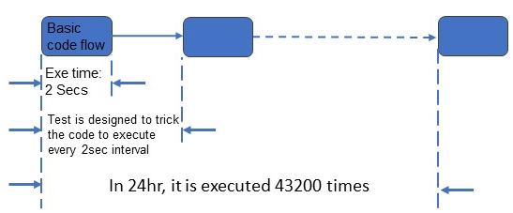
Soak Testing continued
SOFTWARE QUALITY CONFERENCE
PACIFIC NW
Time compressing the event trigger from 5 minutes to every 2 seconds.
In a 24-hour period : 43,200 times (150 days of production environment)
With this trend, in 36hrs we would have 64,800 executions. This could be soak test under ideal conditions.
Further time compression of the event by continuously triggering of the same block of code. This represents positive flow (non-deviant) soak test
PNSQC ™

Slide 15
Soak Testing continued
SOFTWARE QUALITY CONFERENCE
PACIFIC NW
This represents the parallelization of the continuous testing of the same positive flow of code. This test also begins to represent a positive flow, DoS simulation.
This is deviation flow test being executed in the soak test. This scenario begins the transformation from the positive flow, DoS simulation to the deviation flow, DoS simulation.
This illustrates one positive flow, among a series of deviation flows. This is a full deviation flow, DoS simulation.
PNSQC ™

Slide 16
Guidelines for Running Soak Tests
SOFTWARE QUALITY CONFERENCE
PACIFIC NW
Resource counters:
Private Bytes and Handle count
Test duration:
25% run time as test ramp up time with no load
100% run time
25% of time should be post-cooling, state where all the load is taken off
Resource leak and DoS indicators
For Private Bytes: After initial ramp up, 500KB/hr. for more than 4hrs, is a concern
For handle count: 25 handles/hr. for consecutive 4hrs is a concern
Tool to use : Perfmon (for Windows)
PNSQC ™

Slide 17
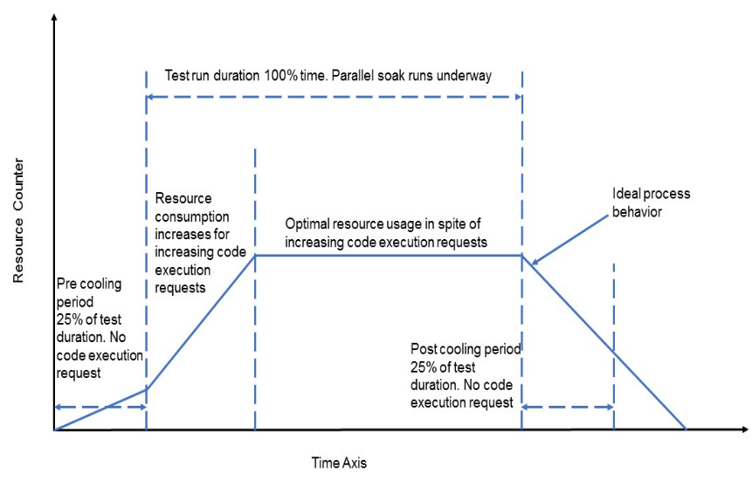
Analyzing resource utilization trends
SOFTWARE QUALITY CONFERENCE
PACIFIC NW
Ideal process behavior during soak test
1st spike in memory or handle consumption: When actual test starts the memory and handle counts begin to ramp until optimal resource usage is achieved. For some, its 30-40 mins and in some cases, it may take 1-2 hrs as well.
Decreasing trend: Once the test is over, resources consumed are freed, displaying ideal behavior
PNSQC ™

Slide 18
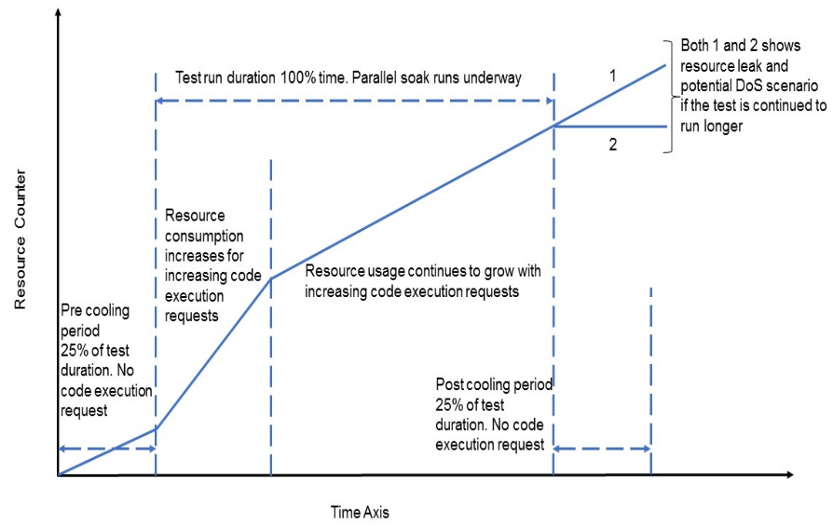
Analyzing resource utilization trends
SOFTWARE QUALITY CONFERENCE
PACIFIC NW
Process showing signs of memory leak and DoS vulnerability
This illustrates a process resource utilization graph
Resource utilization keeps increasing with increasing code executions requests.
If the code execution requests would have continued, it would have been a potential DoS
PNSQC ™

Slide 19
Parallel Soak Testing and how it is linked to Security Testing
SOFTWARE QUALITY CONFERENCE
PACIFIC NW
PNSQC ™

Slide 20
Case study
SOFTWARE QUALITY CONFERENCE
PACIFIC NW
On a popular OS type, we created two types of files: type A and type B. Both files are text files with varying content. Each file type creation triggers specific code flow execution
System configuration: 8GB RAM, 8 Core, 100GB HDD
Start
Create file
Is it a Type A file or Type B file
For Type B file, inspect the file and log the file name
Stop
For Type A file, inspect the file and don’t log anything
PNSQC ™

Slide 21
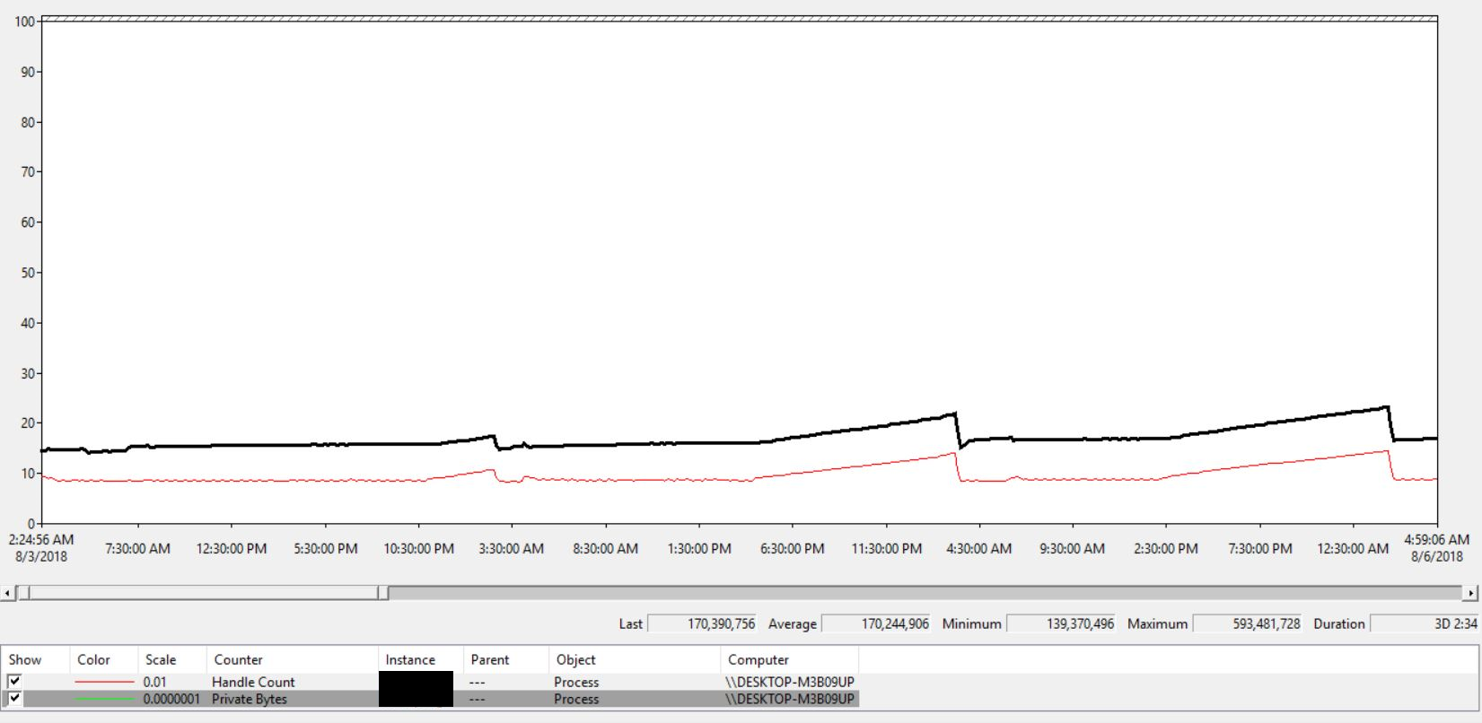
Case study
SOFTWARE QUALITY CONFERENCE
PACIFIC NW
Simulation A
Type A files are created with maximum allowed file name length. Default maximum length of file name is 256 characters.
Test Duration: 3Days 2hrs, Private Bytes: Max value ~565MB.
PNSQC ™

Slide 22
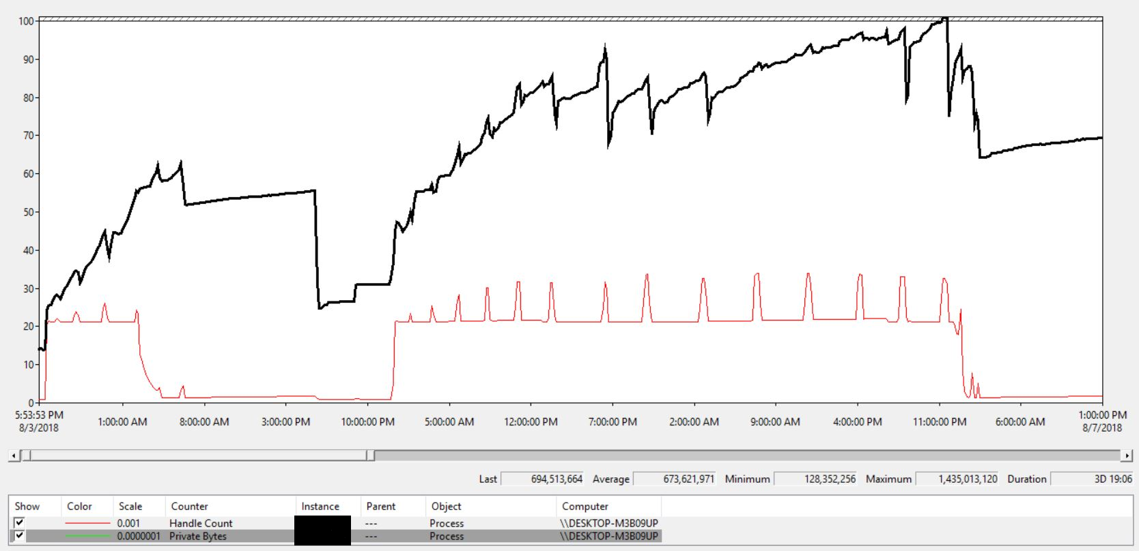
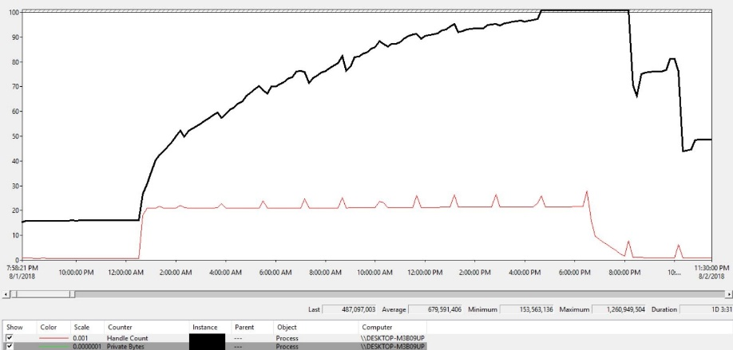
Case study
SOFTWARE QUALITY CONFERENCE
PACIFIC NW
Simulation B
Type B files are created with short file names (8-15 characters)
With each type B file creation, memory consumption keeps increasing and continues to grow
Test Duration: 3Days 19hrs, Private Bytes: Max value ~1.3 GB.
Type B files are created with maximum allowed file name length
Multiple type B file creation events along with max length of file name, we see trends of DoS.
Test Duration: 1Day 3hrs, Private Bytes: Max value ~1.2GB.
Simulation C
PNSQC ™

Slide 23
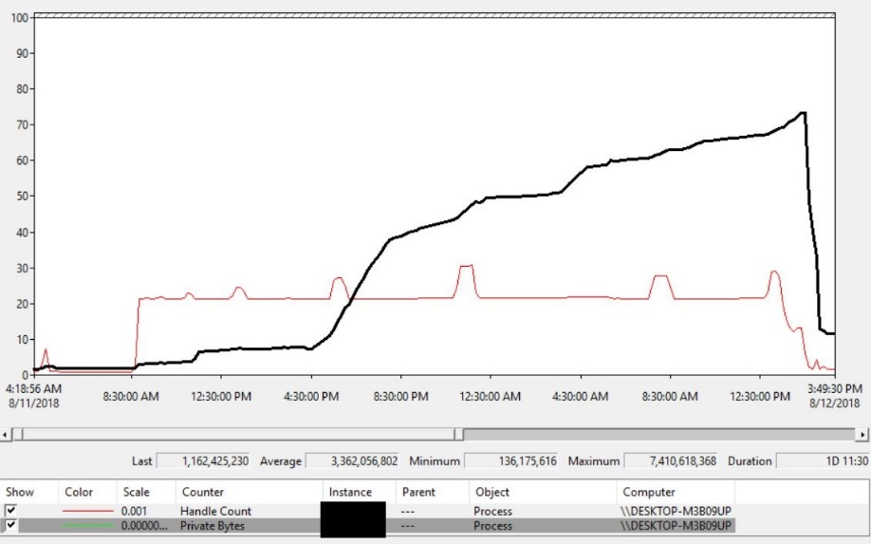
Case study
SOFTWARE QUALITY CONFERENCE
PACIFIC NW
Simulation D
Parallel soak of type B file creation with maximum allowed file name length with increased stacking.
We see signs of high memory leak and after a point, a critical service failed. DoS scenario was hit.
After system restart the service fails to restart, as it is unable to load file creation log entries, it is broken permanently.
Test Duration: 1D 11hrs, Private Bytes: Max value ~7 GB.
PNSQC ™

Slide 24
Conclusion
SOFTWARE QUALITY CONFERENCE
PACIFIC NW
Targeted parallel soak tests help expose resource utilization issues and low-rate DoS vulnerabilities in applications.
Traditional performance and security testing do not cover this particular application security vulnerability/performance weakness.
These tests can be achieved by simple rewiring of existing functional tests and adjusting the current performance testing approach.
The parallel soak testing of deviation code flow has a high rate of test case efficiency and yields positive return on investment (ROI) for the organization.
PNSQC ™

Slide 25
Thank You
SOFTWARE QUALITY CONFERENCE
PACIFIC NW
A note of Thank You to our reviewers
John Cvetko and Manini Sharma
You can reach us at:
Vittalkumar Mirajkar (Vittalkumar_Mirajkar@McAfee.com)
LinkedIn: https://www.linkedin.com/in/vittalkumar-mirajkar-a8043120/
Sneha Mirajkar (smirajka@cisco.com)
LinkedIn: https://www.linkedin.com/in/sneha-mirajkar-7985b127/
Narayan Naik (Narayan_Naik@McAfee.com)
LinkedIn: https://www.linkedin.com/in/narayan-naik-1151413b
PNSQC ™

